Slide 1
Industrial Human Resource Geo-Visualization
Technologies : EDA, Visualization, NLP
Domain : Resource Management

Slide 2

Problem Statement
The outdated classification of industrial workforce data in India.
The importance of updating and accurately classifying the workforce based on industry sectors (like manufacturing, retail, agriculture, etc.).
The need for gender-specific and geographical segmentation of worker data to enable better policy making.

Slide 3
Tools Used
EDA: Exploratory Data Analysis (Pandas, NumPy)
Visualization: Plotly, Streamlit
NLP: Techniques used for analyzing industry categories and grouping sectors.

Slide 4




Automating CSV File Merging Using Python
Merge multiple CSV files from a folder into one consolidated file automatically.
Tools Used:
Python – Scripting language
Pandas – Data manipulation
Pathlib – Path management

Slide 5
Exploratory Data Analysis (EDA)
Data Shape & Columns
print(merged_df.shape) 🔹 Shows the number of rows and columns
print(merged_df.columns) 🔹 Lists all column headers
Data Preview
merged_df.head(3) 🔹 Displays the first 3 rows of the dataset 🔹 Quick check for content structure
Statistical Summary
merged_df.describe() 🔹 Provides summary statistics (mean, std, min, max) 🔹 Useful for numeric columns
Missing Values
merged_df.isnull().sum() 🔹 Detects missing data column-wise 🔹 Helps in planning data cleaning
Column Name Cleaning
merged_df.columns = merged_df.columns.str.strip().str.lower().str.replace(" ", "-").str.replace("-", "_")
🔹 Standardizes column names: Lowercase, No spaces or dashes & Ready for consistent referencing in code

Slide 6
Feature Engineering on Workforce Data
Total Workers
merged_df["total_workers"] = merged_df["main_workers___total____persons"] + merged_df["marginal_workers___total____persons"]
Combines main and marginal workers into one total workforce feature.
Useful for understanding overall labor participation.
Gender Ratio
merged_df["female_to_male_ratio"] = merged_df['main_workers___total___females'] / merged_df['main_workers___total___males’]
Calculates the ratio of female to male workers.
Highlights gender balance in the workforce.
Rural/Urban Worker Ratios
merged_df["rural_ratio"] = merged_df['main_workers___rural____persons'] / merged_df['main_workers___total____persons']
merged_df["urban_ratio"] = merged_df['main_workers___urban____persons'] / merged_df["main_workers___total____persons"]
Shows distribution of workers between rural and urban areas.
Helps in analyzing workforce geography and infrastructure needs.

Slide 7
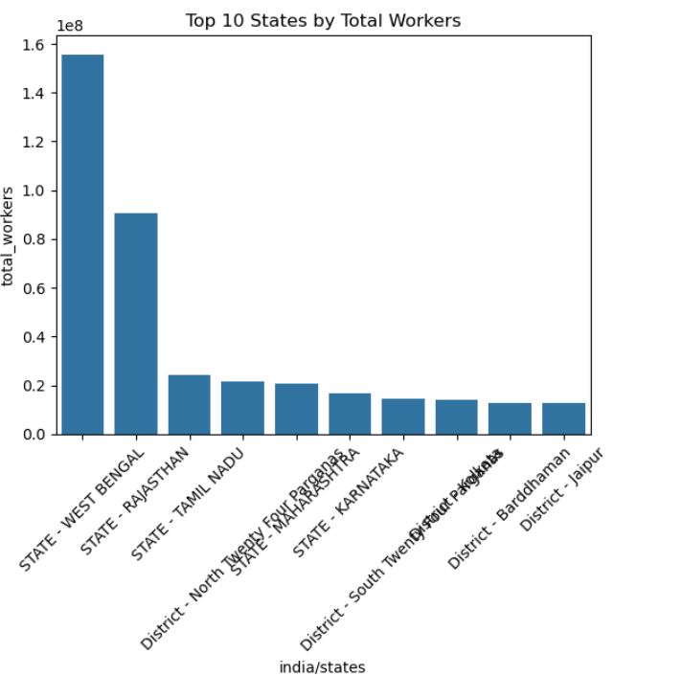
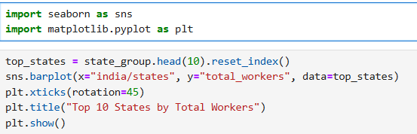
Visualization
Display the top 10 Indian states with the highest number of total workers using a bar plot for clear comparison.
Data grouped by state and sorted by total workers.
Selected the top 10 states for focused visualization.
Bar plots effectively highlight categorical differences and make it easy to compare workforce sizes across states56.
Visual ranking helps quickly identify leading states in terms of workforce.
Supports data-driven discussions and decision-making.

Slide 8
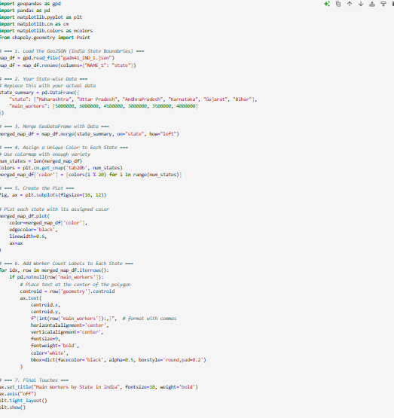
Geo-Visualization

Slide 9
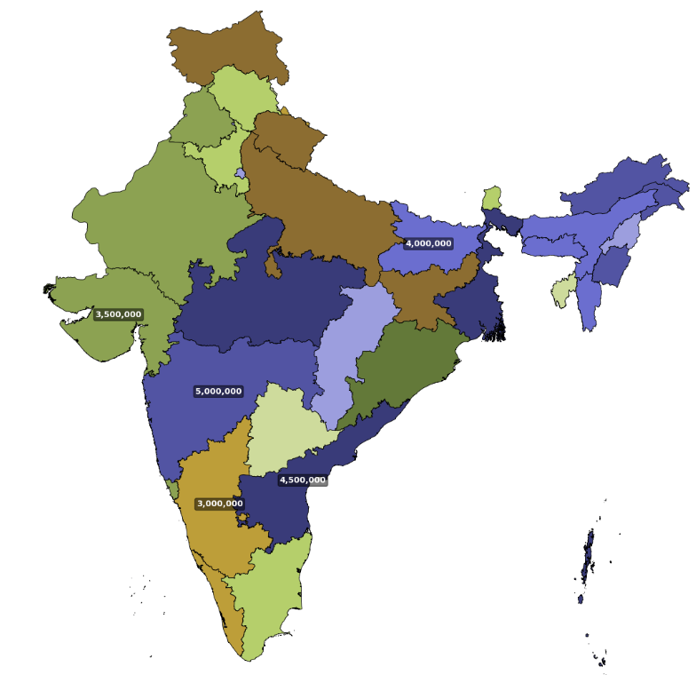
Saving Aggregated Data for Geo-Visualization
Aggregated workforce data by state to enable clear and effective geo-visualization of main and marginal worker distribution across India.
Data Preparation:
Grouped data by state using Pandas to sum total main and marginal workers.
Resulting summary includes three columns: state, main_workers, and marginal_workers.
Exported the aggregated data to a CSV file (state_workforce_summary.csv) for easy integration with mapping tools.
Geo-Visualization Benefits:
Maps make invisible patterns and relationships in workforce data visible, supporting deeper insights and better decision-making

